Slide 1
LeAD SCORing CASE STUDY BY Rajdipa & Munna

Slide 2
Background
An education company named X Education sells online courses to industry professionals. On any given day, many professionals who are interested in the courses land on their website and browse for courses..
The company markets its courses on several websites and search engines like Google. Once these people land on the website, they might browse the courses or fill up a form for the course or watch some videos. When these people fill up a form providing their email address or phone number, they are classified to be a lead. Moreover, the company also gets leads through past referrals. Once these leads are acquired, employees from the sales team start making calls, writing emails, etc. Through this process, some of the leads get converted while most do not.
The typical lead conversion rate at X education is around 30%.And this is where you come in as a data analyst. Your job is to categorise the countries using some socio-economic and health factors that determine the overall development of the country. Then you need to suggest the countries which the CEO needs to focus on the most.
To make this process more efficient, the company wishes to identify the most potential leads, also known as ‘Hot Leads’. If they successfully identify this set of leads, the lead conversion rate should go up as the sales team will now be focusing more on communicating with the potential leads rather than making calls to everyone

Slide 3
Objective
Build a logistic regression model to assign a lead score between 0 and 100 to each of the leads which can be used by the company to target potential leads. A higher score would mean that the lead is hot, i.e. is most likely to convert whereas a lower score would mean that the lead is cold and will mostly not get converted.
There are some more problems presented by the company which your model should be able to adjust to if the company's requirement changes in the future so you will need to handle these as well. These problems are provided in a separate doc file. Please fill it based on the logistic regression model you got in the first step. Also, make sure you include this in your final PPT where you'll make recommendations.

Slide 4
Analysis Approach
Technical Approach:
Data inspection
EDA tasks suitable for this dataset
Data cleaning
Univariate analysis
Bivariate analysis
Data preparation for clustering
Outlier Treatment
Feature Scaling

Slide 5
4. Model building
Various Steps
Creating Dummy variable
Concatenating the master Data Frame
Test-Train split
Scale the three numeric features
Running RFE with 15 variables as output
Creating Prediction
Evaluating Model
Test Set Prediction
5. Conclusion

Slide 6
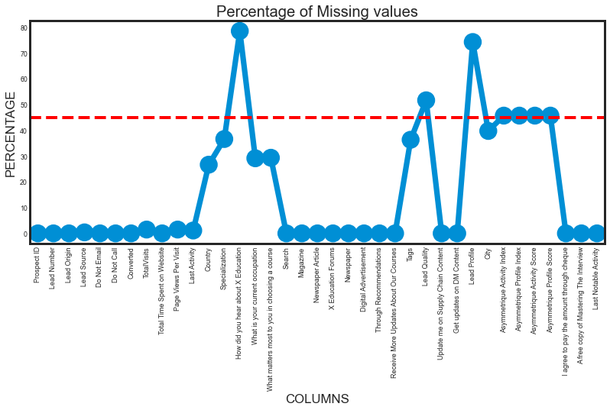
To check missing values
Here we can see that few columns have more than 45% which we have dropped down the line.

Slide 7
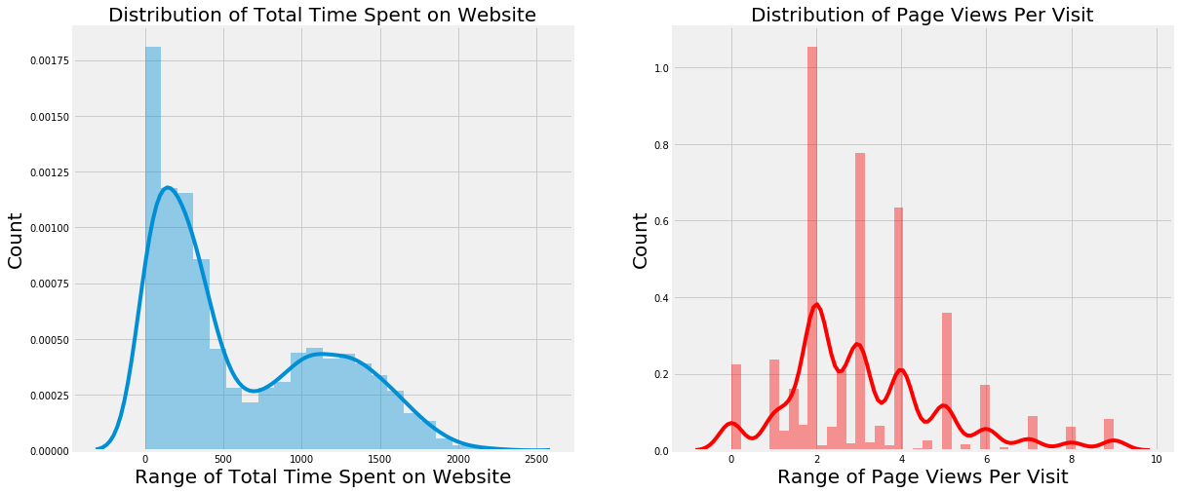
we can infer one thing that at max Page views per visit is 3.8 and total time spent on website is 0.12. Means 2000 Customer likely to spent time on website where as average number of page view per visit is 2
Data Visualisation

Slide 8
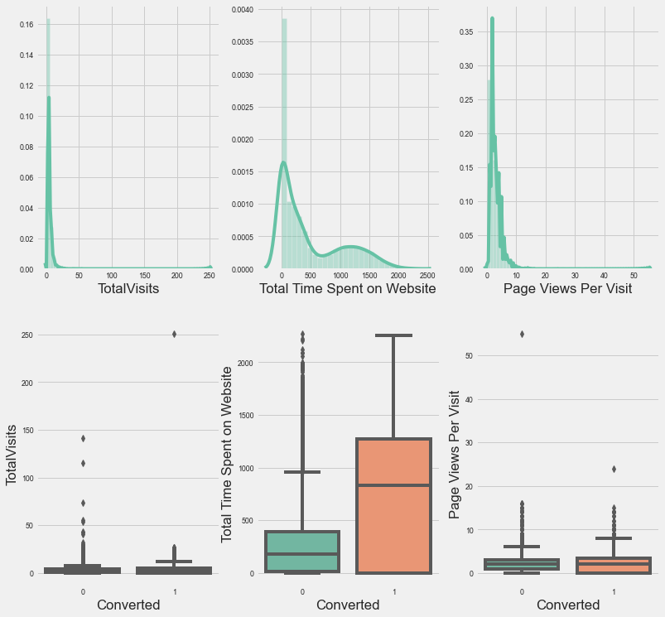
Plots
Though outliers in TotalVisits and Page Views Per Visit shows valid values, this will misclassify the outcomes and consequently create problems when making inferences with the wrong model. Logistic Regression is heavily influenced by outliers. So lets cap the TotalVisits and Page Views Per Visit to their 95 th percentile due to following reasons: Data set is fairly high number
95th percentile and 99th percentile of these columns are very close and hence impact of capping to 95th or 99th percentile will be the same

Slide 9
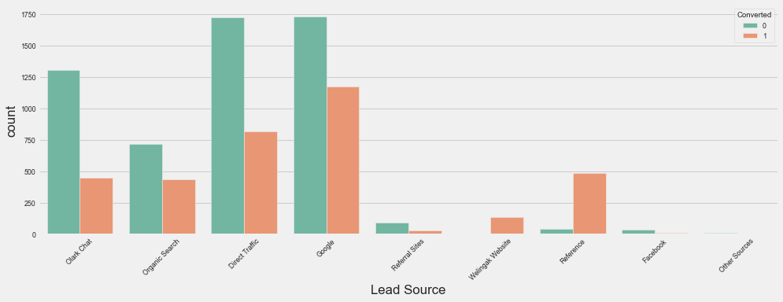
Inference Google and Direct traffic generates maximum number of leads. Conversion Rate of reference leads and leads through welingak website is high. To improve overall lead conversion rate, focus should be on improving lead converion of olark chat, organic search, direct traffic, and google leads and generate more leads from reference and welingak website.

Slide 10
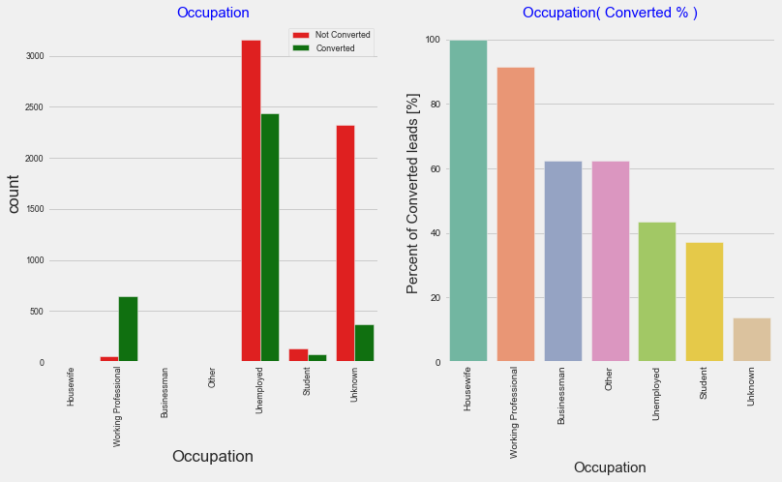
Likelihood of conversion
Insight: Though Housewives are less in numbers, they have 100% conversion rate
Working professionals, Businessmen and Other category have high conversion rate
Though Unemployed people have been contacted in the highest number, the conversion rate is low (~40%)
We cannot combine small value categories as their conversion rate is very different. Combining them may provide wrong predictions.

Slide 11
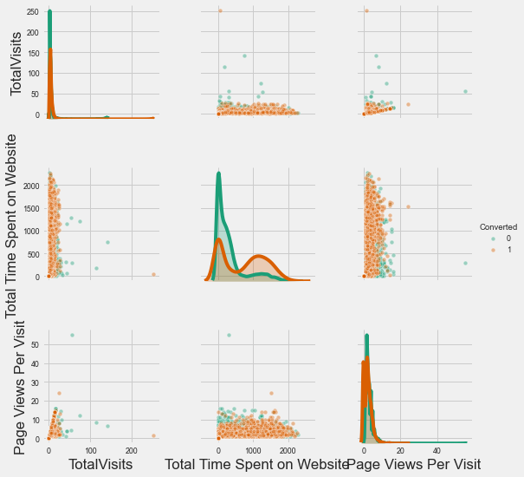
Bivariate analysis
By pair plot we can able to see the pattern of highest correlation with the target variable

Slide 12
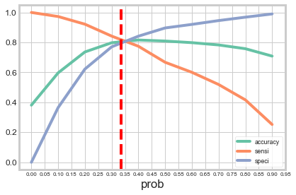
Analysis results
From the above graph, 0.335 seems to be ideal cut-off points.

Slide 13
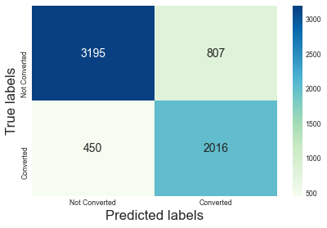
Confusion matrix
Inferences: Model 9 with cut off value at 0.335 is providing an Accuracy of 80.55%, Sensitivity of 80.29%. Sensitivity in this case indicates how many leads the model identify correctly out of all potential leads which are converting. More than 80% is what the CEO has requested in this case study. F1 Score and precision value in the model has higher number for 0's than 1's. This indicates that the model predicts leads which will not convert ( i.e. filtering leads who will not convert) than the leads which will convert. This indirectly improved the model's performance to identify correct leads to be contacted.

Slide 14
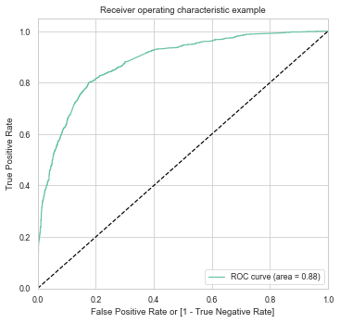
Roc curve
Inferences: ROC Curve aread is 0.88, which indicates that the model is good

Slide 15
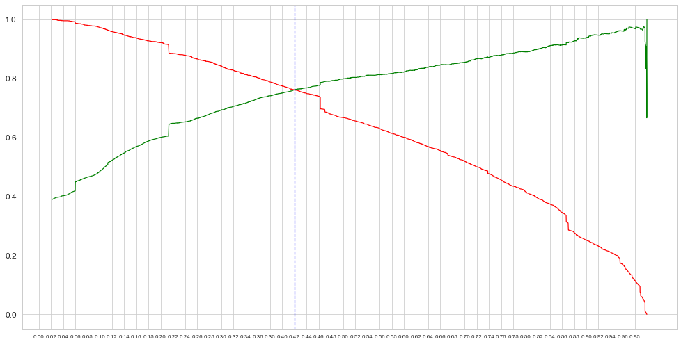
Precision - Recall Trade off
Based on Precision- Recall Trade off curve, the cutoff point seems to 0.404. We will use this threshold value for Test Data Evaluation. By using the Precision - Recall trade off chart cut-off points, the model output has changed the following way :True Positive number has decreased.
True Negative number has increase
False Negative number has increase
False Positive number has decreased
For our purpose CEO wants to identify the people correctly who will convert to leads. Thus, we cannot use Precision-Recall trade-off method as it reduced True Positive. We have to increase Sensitivity / Recall value to increase True Positives. Thus we will use 0.335 as cutoff point.

Slide 16
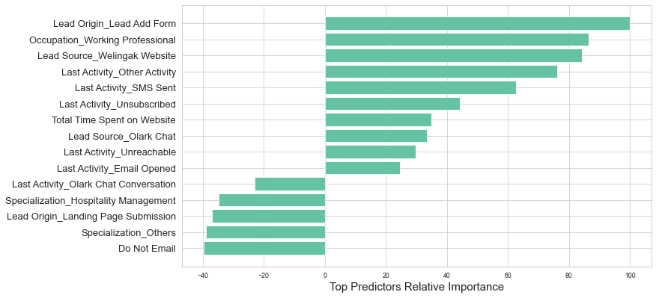
Conclusion
 | Prospect_IND | Converted_IND | Converted_Prob | final_predicted | lead_score
0 | 4269 | 1 | 0.74 | 1 | 74
1 | 2376 | 1 | 0.92 | 1 | 92
2 | 7766 | 1 | 0.74 | 1 | 74
3 | 9199 | 0 | 0.07 | 0 | 6
4 | 4359 | 1 | 0.79 | 1 | 79
Inferences: We can use the lead_score column to identify which potential leads to prioritize first. The higher the score, the higher chances are there for the lead to convert. If there are limited sales representatives, then score cut-off should be higher to ensure a higher conversion probability people are contacted further to turn them into a potential customer. It is the same as increasing the precision value of the model by adjusting the cut-off point to a higher value. In case there are more resources available in the sales team (i.e., interns, etc. ), then the score cut-off can be lowered. As there are more human resources, the company can afford a higher rate of False positives as it will increase the customer outreach and, in turn, increase the potential customer who will take the online courses.

Slide 17
Recommendations
In any Ed-tech, sales is directly proportionate to the pipeline or funnel created by the BDE. Though in order to get connected to A grade lead(Warm/Hot lead), they need to focus on the engaged leads, on priority basis. Be the ‘Lead Origin-Landing Page Submission’, as these set of leads are with intent and are looking forward to join particular programs, thus marking them as Hot leads.
Second set of leads need to focus on are - who are having a good amount of Watchtime or Total Time Spent on Website, as the lead are doing their part to learn about the platform more. These set of leads will be tactical and rational in approach and needed to handle with good product knowledge and objection handling skills.
Afterwards while the probing part is happening, the agent get acquainted with the job roles and paying capacity alongside need generation. Thus putting proper tags.
Focus should be on working professionals as conversion rate is highest there.
Website should be made more engaging as it seems to be the single most important factor determining conversion
Leads from google are very good for business . Business should increase its engagement with them.
SMS seems to be more effective than mails.
Search Engine Optimization can increase more direct traffic and can increase total visit which may be good for business
Olark chat conversation also seems to be quite effective.

Slide 18
Thank You

